Slide 1
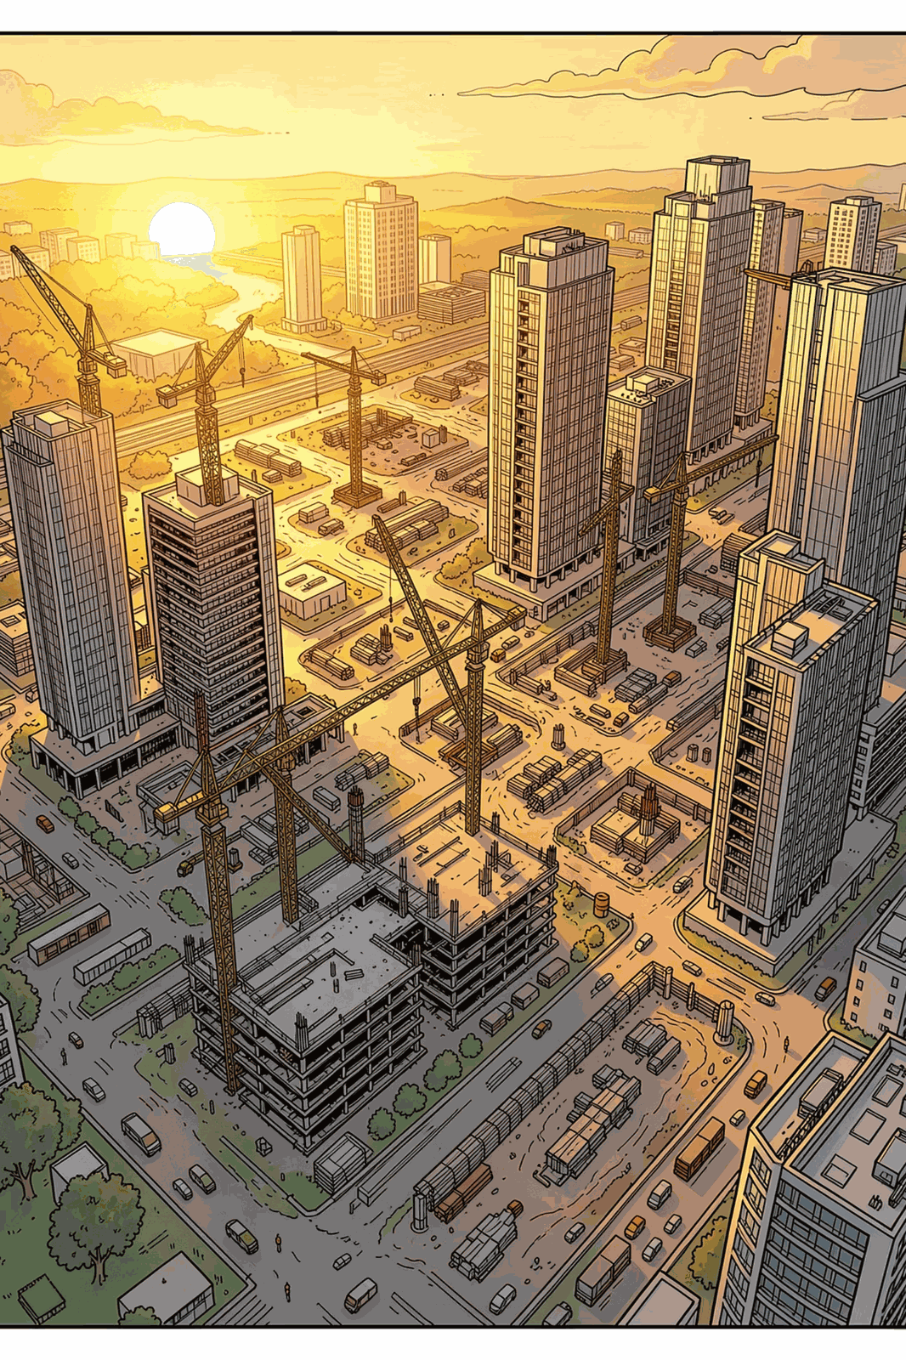
INTEGRATED FINANCIAL MODEL
Larsen & Toubro: Valuation Analysis
A 3-statement + DCF valuation model with actuals through FY26 and forecasts through FY31, in INR crore. L&T is positioned as a strong growth and margin recovery story, with revenue projected to grow at ~9.0% CAGR and EBITDA margins recovering from 8.3% to 14.1%.

Slide 2
HEADLINE CONCLUSION
A Compelling Margin Recovery Story
FY26 is the trough. From FY27 onward, the model projects a sustained rebound — making margin normalization the primary value driver. Revenue and profitability expand meaningfully through FY31E.
₹153K Cr
₹236K Cr
8.3%
FY26A Revenue
FY31E Revenue
FY26A EBITDA Margin
Base year (trough)
~9.0% CAGR
Compressed baseline
14.1%
₹25K Cr
FY31E EBITDA Margin
FY31E Net Profit
Normalized target
Up from ₹6K Cr in FY26A

Slide 3
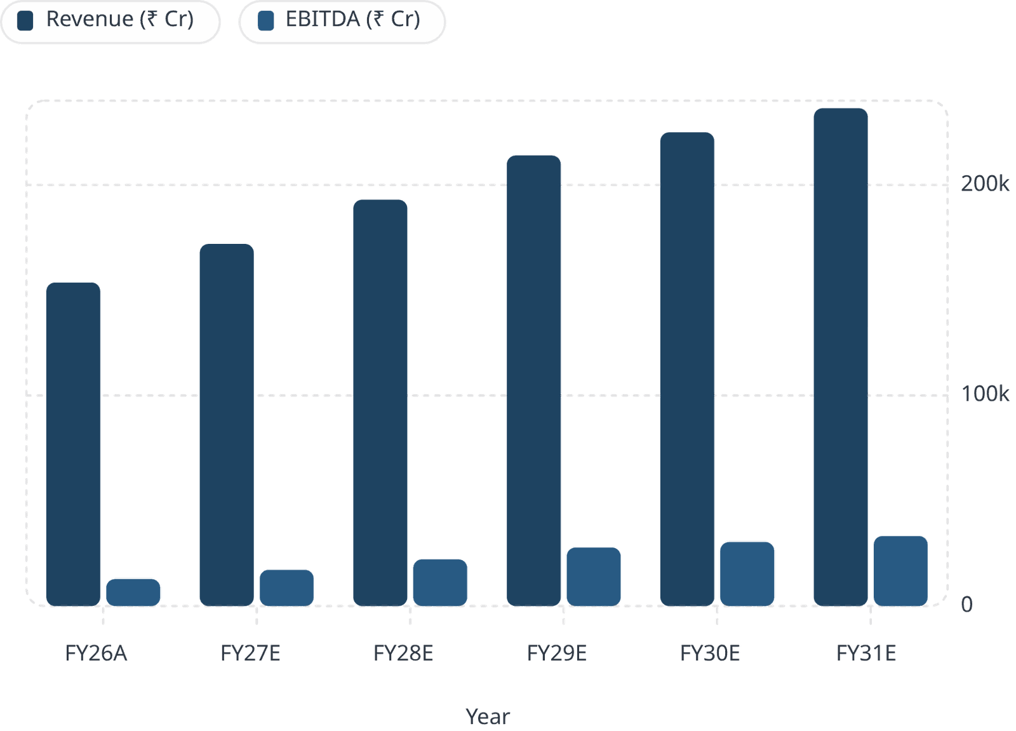

REVENUE & PROFITABILITY
Revenue Growth and EBITDA Expansion
Growth Trajectory
Revenue compounds at ~9.0% CAGR, while EBITDA grows significantly faster — from ₹12,802 Cr to ₹33,275 Cr — driven by operating leverage and margin recovery. The divergence between revenue and EBITDA growth underscores the efficiency gains embedded in the forecast.
EBITDA margin expands from 8.3% to 14.1% — a 580 bps improvement over five years, reflecting the core investment thesis.

Slide 4
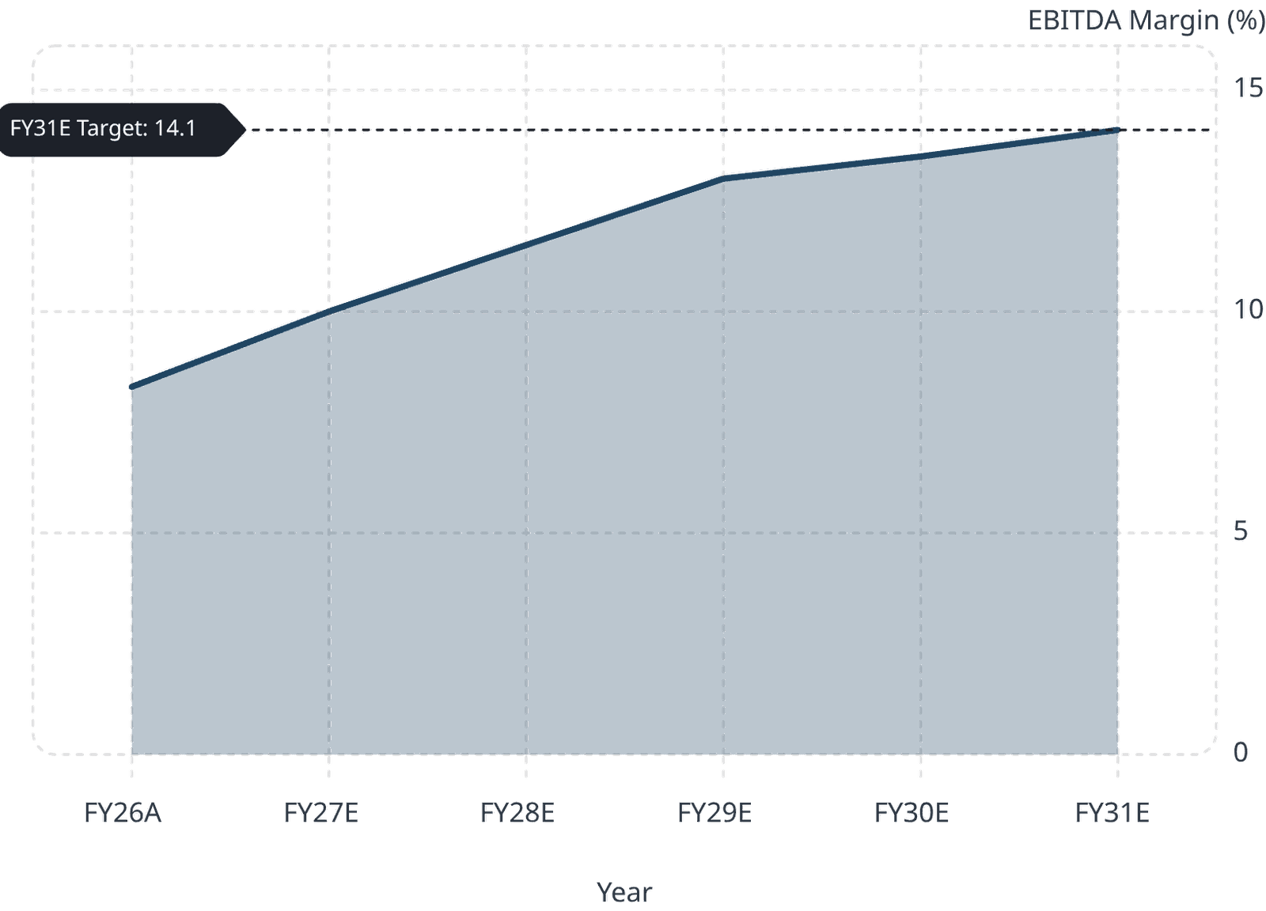
PROFITABILITY RECOVERY
EBITDA Margin: The Core Investment Case
Margin Normalization Driver
FY26's 8.3% EBITDA margin reflects unusually high operating expenses — treated as a one-off trough. The model assumes a steady recovery path, with net profit margin expanding above 10% by FY31E. This trajectory is consistent with L&T's historical margin profile and improved project execution efficiency.
580 bps EBITDA margin expansion over the forecast period
Net profit margin crosses 10% threshold by FY31E
Operating leverage is the primary catalyst for margin recovery

Slide 5
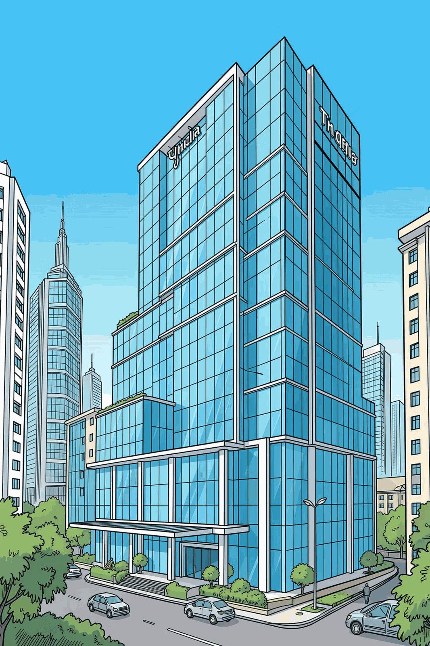
BALANCE SHEET
Balance Sheet Strengthens Materially
Shareholders' funds more than double over the forecast period, while cash builds significantly — reflecting strong retained earnings and disciplined capital allocation.
Shareholders' Funds
Cash Position
₹74,533 Cr → ₹163,989 Cr
More than 2x growth by FY31E
₹7,544 Cr → ₹31,946 Cr
4x increase, strengthening liquidity
Equity Build-Up
Driven by retained earnings from improving profitability and reduced dividend payout pressure

Slide 6
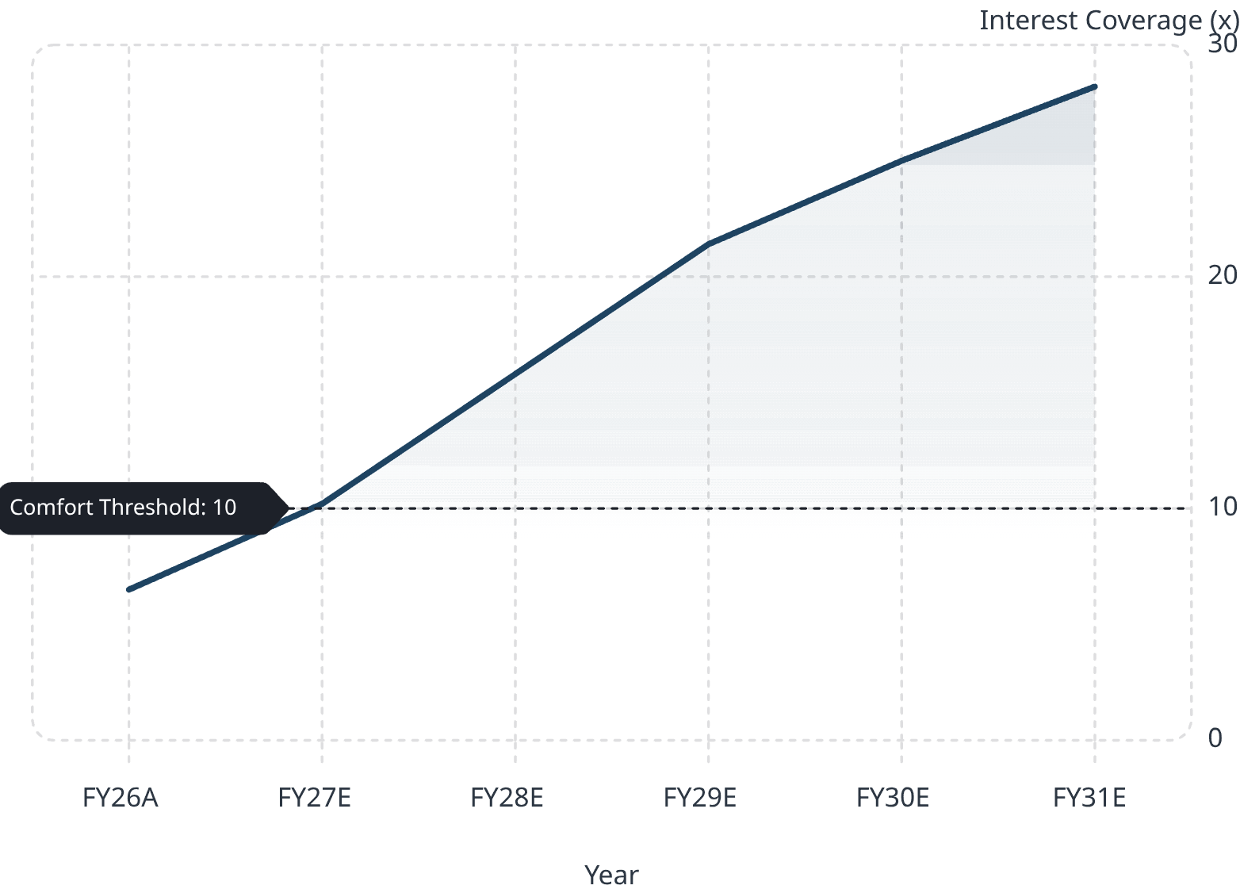

LEVERAGE & CREDIT RISK
Deleveraging: A Sharply Improving Credit Profile
Key Leverage Metrics
L&T's credit profile improves dramatically over the forecast horizon. The debt-to-equity ratio falls to near-negligible levels, while interest coverage strengthens to well above any comfort threshold — signaling substantially lower credit risk.
Debt-to-Equity
Interest Coverage
0.14x (FY26A) → 0.04x (FY31E)
6.5x (FY26A) → 28.2x (FY31E)

Slide 7
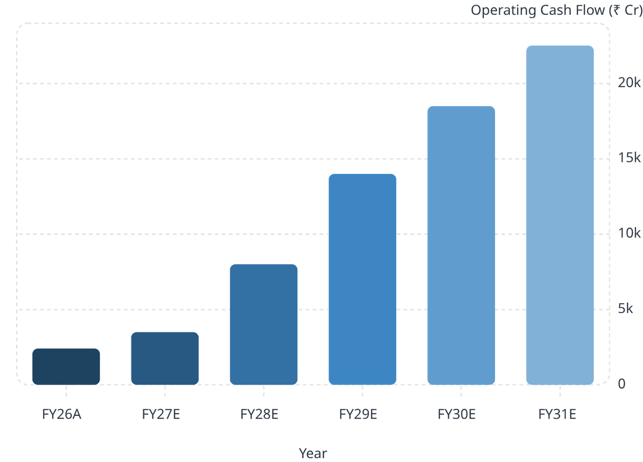

CASH FLOW ANALYSIS
Operating Cash Flow: Strong Recovery, FY27 Exception
The FY27 Cash Dip
While operating cash flow recovers strongly to ₹22,516 Cr by FY31E, closing cash dips sharply to ₹2,290 Cr in FY27 — driven by heavy reinvestment and working capital outflows.
FY27 is a transitional year: high capital allocation and working capital build-up temporarily suppress the cash balance before the recovery takes hold.

Slide 8
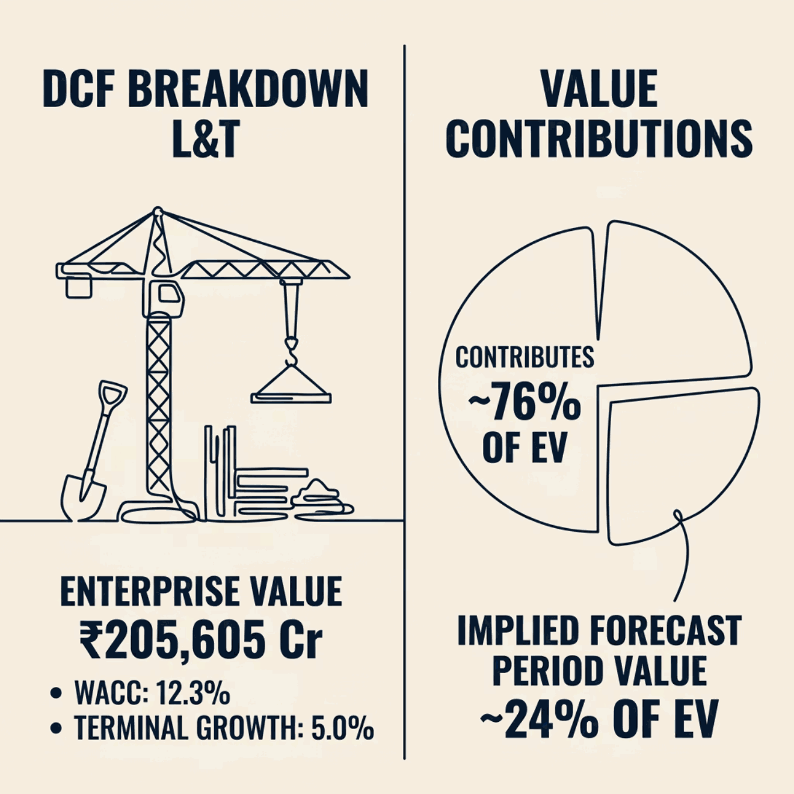

DCF VALUATION
Valuation Output: Attractive but Terminal-Value Heavy
Key Assumptions
The selected DCF case produces an enterprise value of ₹205,605 Cr and equity value of ₹223,600 Cr. The WACC of 12.3% reflects L&T's cost of capital, while the 5.0% terminal growth rate assumes long-term convergence toward India's nominal GDP growth.
~76% terminal value contribution warrants sensitivity analysis around growth and WACC assumptions.
WACC
Terminal Growth
Terminal Value Share
12.3%
5.0%
~76% of EV

Slide 9
INVESTMENT THESIS
Six Key Financial Takeaways
01
02
FY26 is the Trough
Profitability Recovery is Core
Sharp margin compression from high opex; rebound assumed from FY27 onward.
EBITDA margin expands 580 bps; net profit margin crosses 10% by FY31E.
03
04
Balance Sheet Strengthens
Leverage Declines Sharply
Shareholders' funds more than double; cash grows 4x through FY31E.
Debt-to-equity falls to 0.04x; interest coverage reaches 28.2x — materially lower credit risk.
05
06
Cash Flow Improves, FY27 Weak
DCF Attractive, Terminal-Value Heavy
OCF rises to ₹22,516 Cr by FY31E, but FY27 cash dips to ₹2,290 Cr on reinvestment.
Equity value of ₹223,600 Cr; ~76% terminal value contribution warrants sensitivity checks.

Slide 10
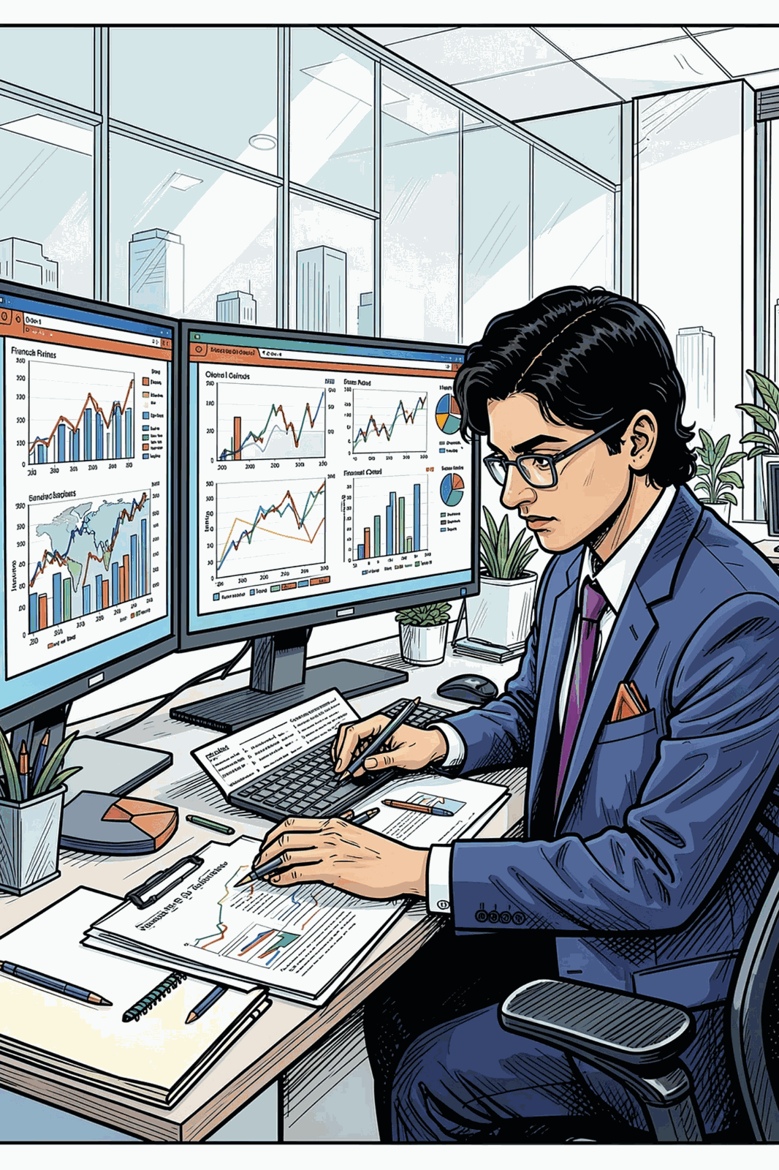
SUMMARY
Bottom Line: A High-Conviction Recovery Play
L&T's model tells a clear story — FY26 is the low point, and every major metric improves meaningfully thereafter. Margin recovery, deleveraging, and cash generation converge to support an attractive valuation.
Growth
~9.0% revenue CAGR through FY31E
Margin
EBITDA margin expands from 8.3% to 14.1%
Balance Sheet
Debt-to-equity falls to 0.04x by FY31E
Valuation
Equity value of ₹223,600 Cr; terminal-value sensitivity noted

